Slide 1
SWE 4101
Lec – 6
Software Testing
All contents are based on textbooks, research articles, online resources, and personal experience.

Slide 2
SW Testing
Software Testing is a process where the software is evaluated to determine that it meets the user needs (validation) and that the process to build the software was followed correctly(verification).
in other way,
Validation: Are we building the right product?
Verification: Are we building the product right?

Slide 3

Testing : Why do we Perform
Testing fulfills two primary purposes:
to demonstrate quality or proper behavior;
to detect and fix problems.
finding and eventually fixing defects is the Number one reason for software testing. But the truth is, no Software is free from Defect.
If all software is released to customers with defects, why should we spend so much time, effort, and money on testing?

Slide 4
Testing: Why is it Important
Most of us have had an experience with systems that don’t work as expected. This can have a huge impact on a company, including:
    Financial loss – losing business is bad enough but in extreme cases there are financial penalties for non-compliance to regulations
    Increased costs – these tend to be the result of having to implement a manual workaround but can include staff not being able to work due to a fault or failure and the cost of fixing the issues after go-live
    Reputational loss – if the company is unable to provide service to their customers due to software problems then the customers will probably take their business elsewhere
It is important to test the system to ensure it is error free

Slide 5
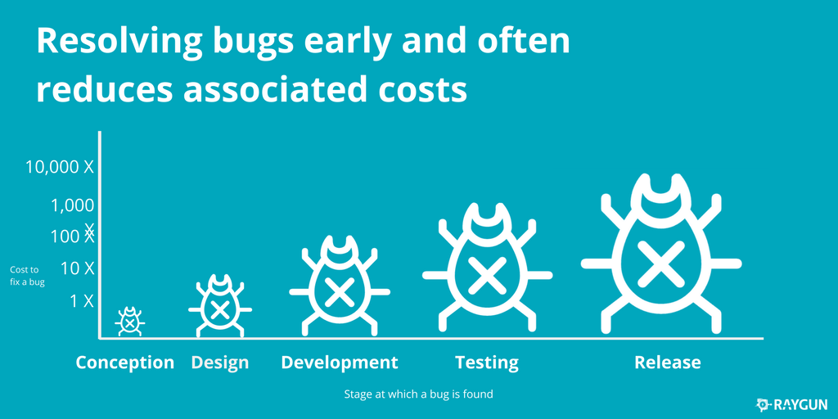
Cost of Late Testing
Early testing can save significant money for the company!

Slide 6
GOALS OF SOFTWARE TESTING
Immediate Goals
Bug discovery
Bug prevention
Testing
Post-implementation Goals
Reduced maintenance cost
Improved testing process
Long-term Goals
Reliability
Risk management
Quality
Customer satisfaction

Slide 7


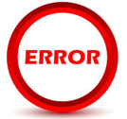
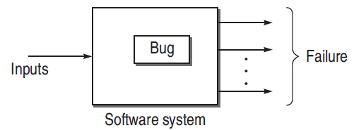

Testing Terminology
Failure
Fault/Defect/Bug
Error
Is the inability of a system or component to perform a required function according to its specification.
is an error in code due to incorrect design, logic, or implementation where the software does not behave as expected.
Whenever a development team member makes a mistake in any phase of SDLC, errors are produced. It might be a typographical error, a misleading
of a specification, a misunderstanding of what a subroutine does, and so on.

Slide 8
Why Do Bugs Occur?
Faulty definition of requirements
  ▪ Erroneous requirement definitions
  ▪ Absence of important requirements
  ▪ Incomplete requirements
  ▪ Unnecessary requirements included
Client-developer communication failures
  ▪ Misunderstanding of client requirements presented in writing, orally, etc.
  ▪ Misunderstanding of client responses to design problems
Coding errors
  ▪ Errors in interpreting the design document, errors related to incorrect use of programming language constructs, etc.

Slide 9
Why Do Bugs Occur?
Deliberate deviations from software requirements
  ▪ Reuse of existing software components from previous projects without complete analysis
  ▪ Functionality omitted due to budget or time constraints
  ▪ “Improvements” to software that are not in requirements
Logical design errors
  ▪ Errors in interpreting the requirements into a design (e.g. errors
  in definitions of boundary conditions, algorithms, reactions to
  illegal operations,...)
Shortcomings of the testing process
  ▪ Incomplete test plan
  ▪ Failure to report all errors/faults resulting from testing
  ▪ Incorrect reporting of errors/faults
  ▪ Incomplete correction of detected errors

Slide 10
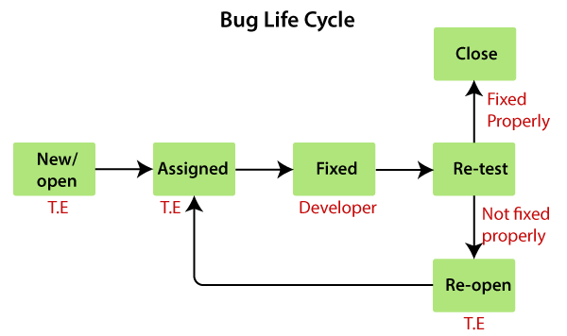
Defect/Bug Life Cycle
Others status of the bug
Following are the different status of the bug:
  Invalid/rejected
  Duplicate
  Postpone/deferred
  Can't fix
  Not reproducible
  RFE (Request for Enhancement)

Slide 11
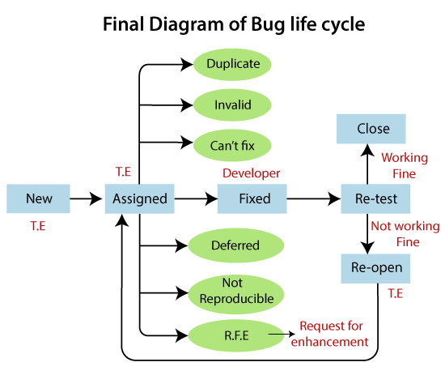
Defect/Bug Life Cycle

Slide 12
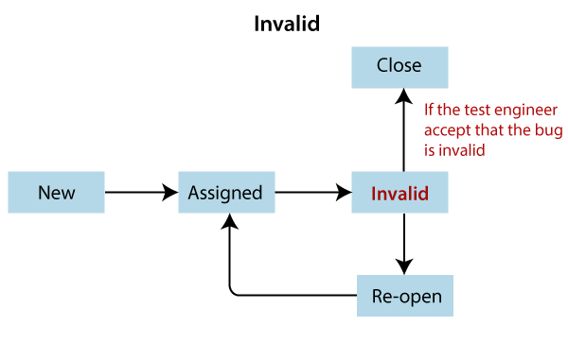
Invalid Bug
Any bug which is not accepted by the developer is known as an invalid bug.
Reasons for an invalid status of the bug :
Test Engineer misunderstood the requirements
Developer misunderstood the requirements
Research Area:
A data-driven approach for understanding invalid bug reports: An industrial case study
Deep Learning-Based Valid Bug Reports Determination and Explanation

Slide 13
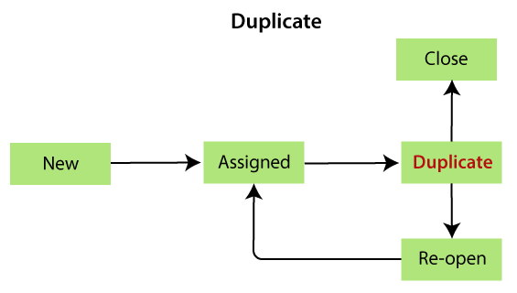
Duplicate Bug
When the same bug has been reported multiple times by the different test engineers are known as a duplicate bug.
Reasons for an duplicate status of the bug :
Common features
Dependent Modules
Research Area:
Characterizing Duplicate Bugs: An Empirical Analysis
Duplicate Bug Report Detection and Classification System Based on Deep Learning Technique
Duplicate Bug Report Detection Using Dual-Channel Convolutional Neural Networks

Slide 14
Not Reproducible
These are the bug where the developer is not able to find it, after going through the navigation step given by the test engineer in the bug report.
Reasons for the not reproducible status of the bug
Incomplete bug report
The Test engineer did not mention the complete navigation steps in the report.
Environment mismatch
Environment mismatch can be described in two ways:
    Server mismatch
    Platform mismatch

Slide 15
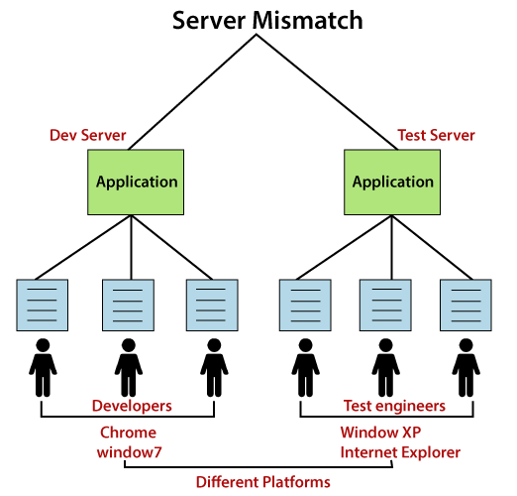
Not Reproducible
    Server mismatch
Test Engineer is using a different server (Test Server), and the Developer is using the different server (Development Server) for reproducing the bug
Platform mismatch:
Test engineer using the different Platform (window 7 and Google Chrome browser), and the Developer using the different Platform (window XP and internet explorer) as well.

Slide 16
Not Reproducible
Data mismatch
Different Values used by test engineer while testing & Developer uses different values.
For example:
The requirement is given for admin and user.
Test engineer(user) using the below requirements: | the Developer (admin) using the below requirements:
User name → abc Password → 123 | User name → aaa Password → 111

Slide 17
Not Reproducible
Build mismatch
The test engineer will find the bug in one Build, and the Developer is reproducing the same bug in another build. The bug may be automatically fixed while fixing another bug.
Inconsistent bug
The Bug is found at some time, and sometime it won't happen.
Solution for inconsistent bug:
As soon as we find the bug, first, take the screenshot, then developer will re-confirm the bug and fix it if exists.

Slide 18
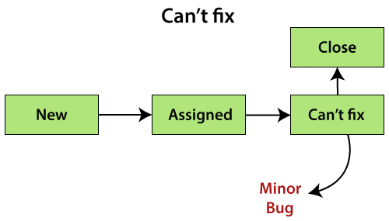
Can't fix
When Developer accepting the bug and also able to reproduce, but can't do the necessary code changes due to some constraints.
Reasons for the can't fix status of the bug
No technology support: The programming language we used itself not having the capability to solve the problem.
The Bug is in the core of code (framework): If the bug is minor (not important and does not affect the application), the development lead says it can be fixed in the next release.
Or , if the bug is critical (regularly used and important for the business) and development lead cannot reject the bug.
The cost of fixing a bug is more than keeping it.

Slide 19
Bug Severity
The impact of the bug on the application is known as severity.
It can be a blocker, critical, major, and minor for the bug.
Blocker: if the severity of a bug is a blocker, which means we cannot proceed to the next module, and unnecessarily test engineer sits idle.
Critical: if it is critical, that means the main functionality is not working, and the test engineer cannot continue testing.
Major: if it is major, which means that the supporting components and modules are not working fine, but test engineer can continue the testing.
Minor: if the severity of a bug is major, which means that all the U.I problems are not working fine, but testing can be processed without interruption.

Slide 20
Bug Priority
Priority is important for fixing the bug or which bug to be fixed first or how soon the bug should be fixed.
It can be urgent, high, medium, and low.
High: it is a major impact on the customer application, and it has to be fixed first.
Medium: In this, the problem should be fixed before the release of the current version in development.
Low: The flow should be fixed if there is time, but it can be deferred with the next release.

Slide 21
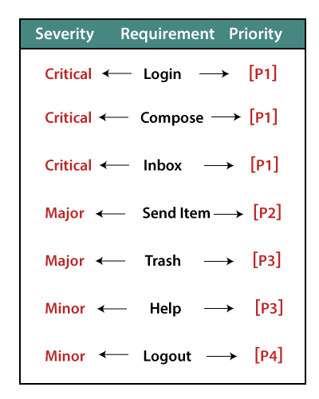
Example of severity and Priority
If we take the case of a login module, then the severity and Priority could depend on the application like as we can see in the below image:
Blocker

Slide 22
Test Case
The tests are usually defined in a document called Test Plan which spells out all the details of the testing to be done, schedules and milestones, responsibilities, testing systems and installation and setup, and the list of test cases to be executed.
Test cases can be manual where a tester follows conditions and steps by hand or automated where a test is written as a program to run against the system.
Tests are usually first defined in a document and often have to be approved by developers and/or testers.
Automated tests may have all the documentation in the code implementing the test case and in the comments.

Slide 23
Fields of a Test Case
There is no specific Rule for it.
But the common information that all test cases should have:
  Unique Test Case name and/or ID: Each test case needs an identifier. Some tests will have both an id and a meaningful name which is derived from the requirement or the functionality being tested.
  Test Scenario and test summary or description: This description should specify what behavior/functionality will be tested by this test case.
  Pre-requisites or setup: What needs to be setup first, such as previous input or commands to the system to execute this test case.
  Test data or inputs: Data to be used for this test case.
  Execution Steps: The steps that have to be done against the system to test the behavior for this test case.
  Expected behavior/Result: what is expected to happen after execution
  Assumptions: Any assumptions that are made about the system or the test case. For example, data dependency or other test case dependency.
  Actual results: what actually happened when the test case was run.
  Status: What is the current status of the test case such as passed, failed, or not tested.

Slide 24
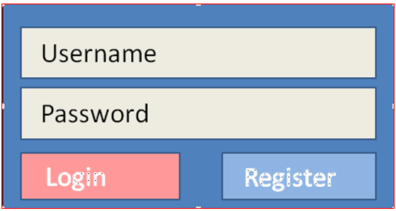

Test Case Exercise
Let’s say we are to test a login functionality that was designed to look like below:
So we have a username and a password fields.
The username is a valid email address and no longer than max valid email address and the password has to be at least 8 characters and no more than 12 characters with only letters and numbers allowed.
Once both registered username and password are entered and Login button clicked, the welcome page will be displayed.
The design indicates that if either username or password is incorrect, we should get the following message above the login area above and the username and password fields should be cleared:

Slide 25
Test Case Exercise
So we define our Test Scenario and Test Cases as follow:
Test Scenario: Verify the login functionality
Test Case 1: Click on Login without typing in username or password
Test Case 2: Type in correct username and nothing for password
Test Case 3: Type in correct password and nothing for username
Test Case 4: Type in incorrect username and incorrect password
Test Case 5: Type in correct username and incorrect password
Test Case 6: Type in incorrect username and correct password
Test Case 7: Type in correct username and correct password
This is not a complete set of possible test cases. For example a username that is not correctly formatted email address; username greater than max size for email address; password less than 8 characters; etc.

Slide 26
Test Case Exercise
Your Test Case 1 would then be defined something like:
Test Case Name/ID | T1-ClickLogin
Test Scenario | Login:
Test Case description | Missing both username and password
Pre-requisites | None
Execution Steps | 1. Click Login button 2. Check the error message 3. Check that there is no text in the username and password fields
Expected behavior/Result | Message will be displayed above login box “The Username and/or password you entered does not match our records. Try again.” Both the username and password fields will be cleared
Assumptions | The GUI design will be tested in a separate test scenario
Actual results
Status | Not Tested

Slide 27
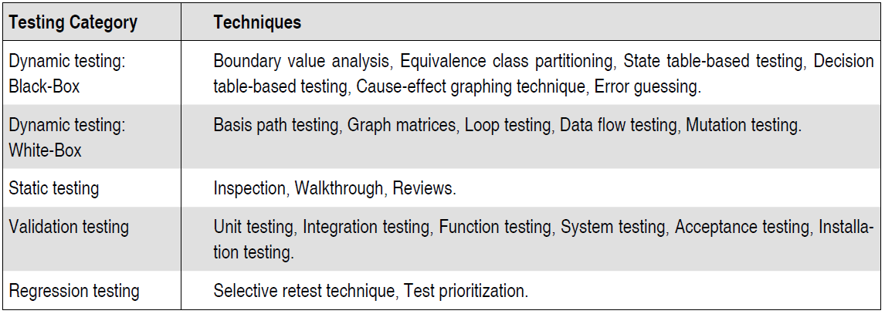
Testing Category & Techniques

Slide 28
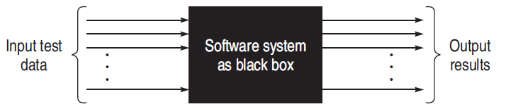
Black-Box Testing
A “black-box” means that one cannot see the internals of the system or inside the box.
A test or a testing activity that is considered “black-box”, only checks that given some input to the SW system, there is expected output.
This technique considers only the functional requirements of the software or module.
An example of such a test is User Acceptance Testing (UAT) where the person doing the testing has no access to the code, is not concerned how the system was implemented, but rather is testing that the system meets the user requirements and works as expected for the typical input that the system needs to work with.

Slide 29
Look at Example
  Let’s assume that we are building a small program that employees at a company can use to determine how much their insurance will cost. Here are the requirements for the application.
  Requirement #1 An employee must have health insurance to get vision or dental insurance.
  Requirement #2 There are two types of health insurance: HMO costs $100 a month; PPO costs $150 a month.
  Requirement #3 Vision costs $25 a month
  Requirement #4 Dental costs $20 a month

Slide 30
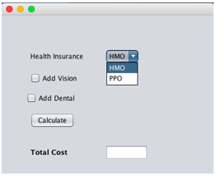
Look at Example
The user interface might look like this. The user selects a health insurance plan and might check boxes to get vision or dental insurance. Then the user clicks the Calculate button. The calculated cost appears in the text field beside the label “Total Cost”.

Slide 31
Black-Box Testing
Black-box testing attempts to find errors in the following categories:
  To test the modules independently
  To test the functional validity of the software so that incorrect or missing functions can be recognized
  To look for interface errors
  To test the system behavior and check its performance
  To test the maximum load or stress on the system
  To test the software such that the user/customer accepts the system within defined acceptable limits

Slide 32

Black-Box Testing : Techniques
1. BOUNDARY VALUE ANALYSIS (BVA)
2. EQUIVALENCE CLASS TESTING
3. STATE TABLE-BASED TESTING
4. DECISION TABLE-BASED TESTING
5. CAUSE-EFFECT GRAPHING BASED TESTING
6. ERROR GUESSING
I will upload the softcopy in google classroom

Slide 33
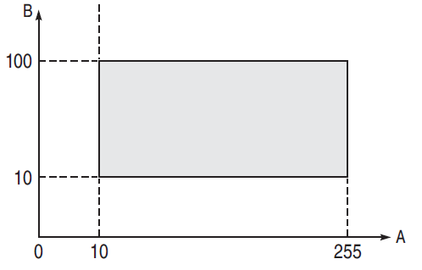
Boundary Value Analysis (BVA)
Test cases designed with boundary input values have a high chance to find errors.
means that most of the failures crop up due to boundary values.
boundary means the maximum or minimum value taken by the input domain.
For example, if A is an integer between 10 and 255, then boundary checking can be on 10(9,10,11) and on 255(256,255,254). Similarly, B is another integer variable between 10 and 100, then boundary checking can be on 10(9,10,11) and 100(99,100,101)

Slide 34
Boundary Value Analysis (BVA)
BVA offers several methods to design test cases:
Boundary Value Checking (BVC)
Robustness Testing Method
Worst-case Testing Method

Slide 35
BVA: Boundary Value Checking
the test cases are designed by holding one variable at its extreme value and other variables at their nominal values in the input domain.
The variable at its extreme value can be selected at:
    (a) Minimum value (Min)
    (b) Value just above the minimum value (Min+ )
    (c) Maximum value (Max)
    (d) Value just below the maximum value (Max−).

Slide 36
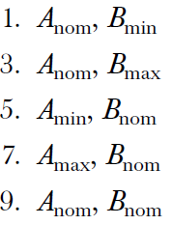
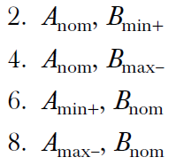
BVA: Boundary Value Checking
Let us take the example of two variables, A and B. If we consider all the above combinations with nominal values, then following test cases can be designed:
It can be generalized that for n variables in a module, 4n + 1 test cases can be designed with boundary value checking method.

Slide 37

BVA: Robustness Testing Method
Is an extension of BVC such that boundary values are exceeded as:
The variable at its extreme value can be selected at:
    A value just greater than the Maximum value (Max+)
    A value just less than Minimum value (Min−)
So if we consider the previous example then we can add following cases :
It can be generalized that for n variables in a module, 6n + 1 test cases can be designed with Robustness Testing method.

Slide 38
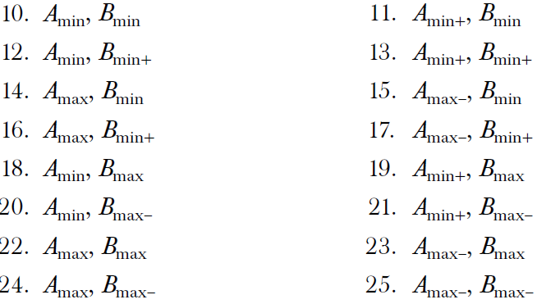
BVA: Worst-Case Testing Method
We can again extend the concept of BVC by assuming more than one variable on the boundary. It is called worst-case testing method.
So if we consider the previous example then we can add following cases to the list of 9 test cases designed in BVC as:
It can be generalized that for n variables in a module, 5^{n} test cases can be designed with Worst-Case Testing method.

Slide 39
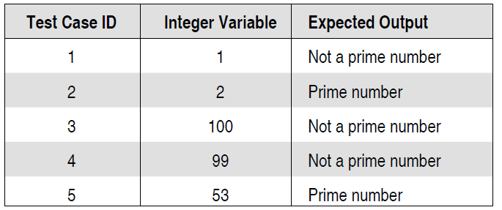
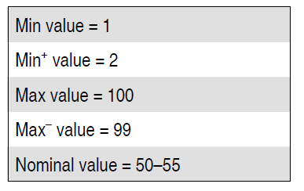
Example
A program reads an integer number within the range [1,100] and determines whether it is a prime number or not. Design test cases for this program using BVC, robust testing, and worst-case testing methods.
Solution:
Test cases using BVC
Total # of test case will be 4n+1 = 5 [as n=1 here]
min and max values
Test cases

Slide 40
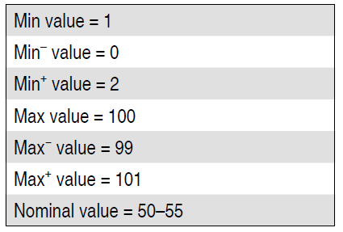
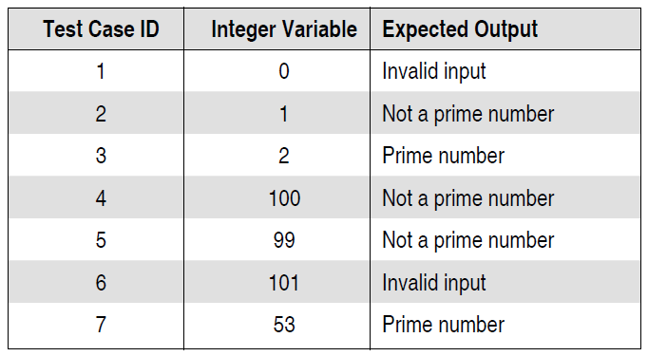
Example
(b) Test cases using Robust testing
Total # of test case will be 6n+1 = 7 [as n=1 here]
min and max values
Test cases

Slide 41
Example
(c) Test cases using worst-case testing
Total # of test case will be 5^{n} = 5 [as n=1 here]
So, the number of test cases will be same as BVC.

Slide 42
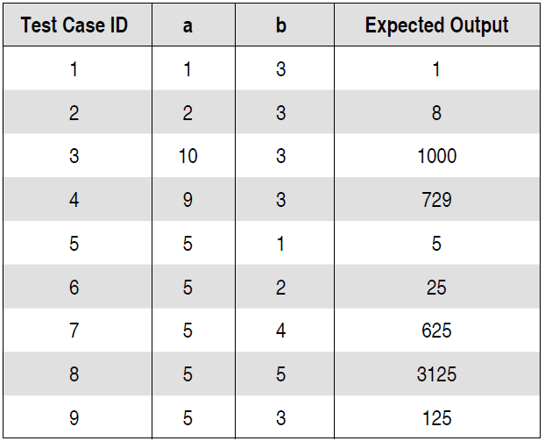
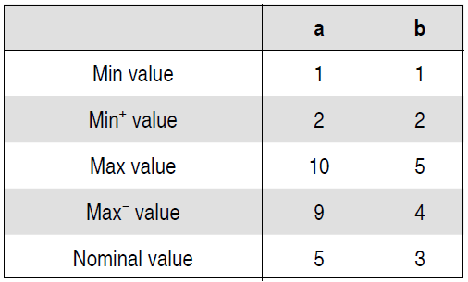
Example
A program computes a^{b} where a lies in the range [1,10] and b within [1,5].Design test cases for this program using BVC, robust testing, and worst-case testing methods.
Solution:
Test cases using BVC : Total # of test case will be 4n+1 = 9 [as n=2]
min and max values
Test cases

Slide 43
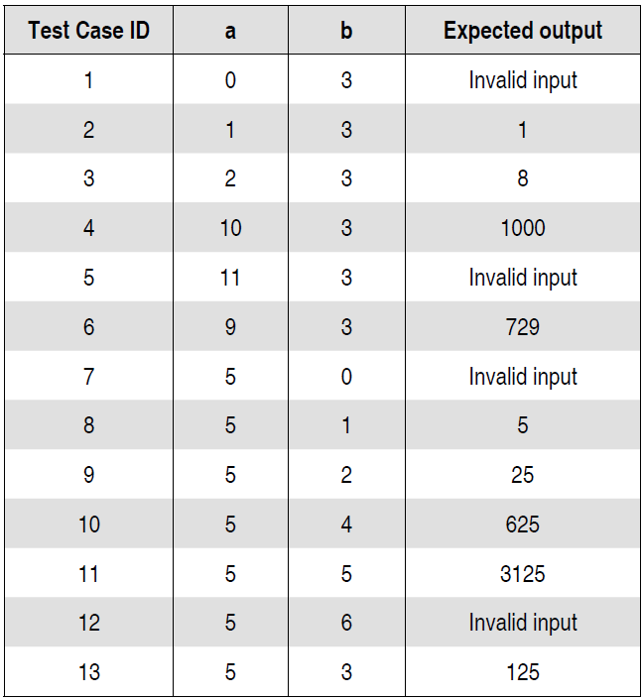
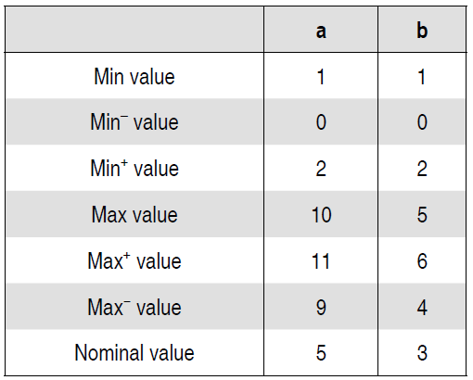
Example
(b) Test cases using Robust testing: Total # of test case will be 6n+1 = 13 [as n=2]
min and max values
Test cases

Slide 44
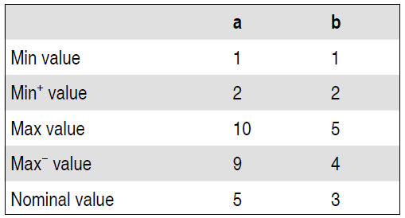
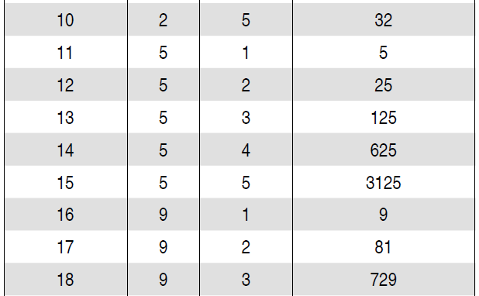
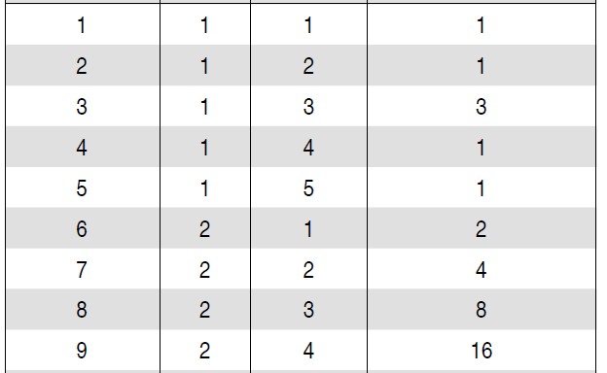
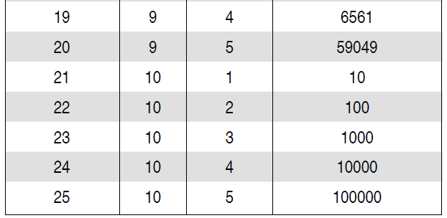
Example
(c) Test cases using worst-case testing
Total # of test case will be 5^{n} = 25 [as n=2]
min and max values

Slide 45
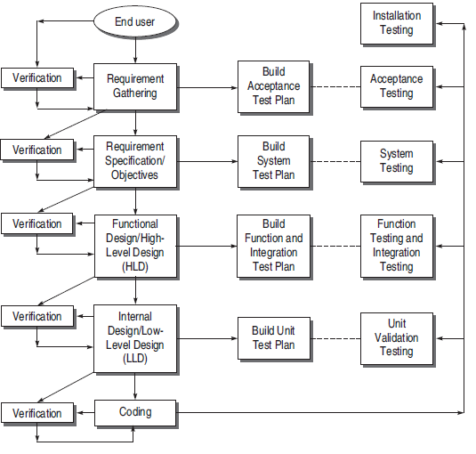
Validation Activities

Slide 46
Integration Testing
In integration testing smaller units are integrated into larger units and larger units into the overall system.
This differs from unit testing in that units are no longer tested independently but in groups, the focus shifting from the individual units to the interaction between them.
The purpose of integration testing is to verify the functional, performance, and reliability between the modules that are integrated.

Slide 47
Integration Testing
Why do we do integration testing?
Unit tests only test the unit in isolation
Many failures result from faults in the interaction of subsystems
Often many Off-the-shelf components are used that cannot be unit tested
Without integration testing the system test will be very time consuming
Failures that are not discovered in integration testing will be discovered after the system is deployed and can be very expensive.

Slide 48
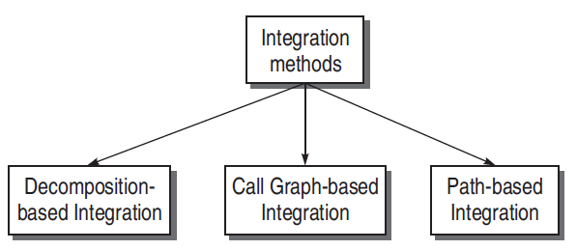
Integration Testing
There are three approaches for integration testing.

Slide 49
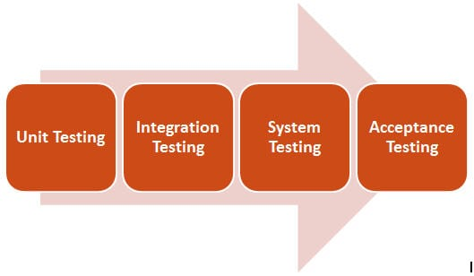
System Testing
is a series of different tests to test the whole system on various grounds (functional & non functional) where bugs have the probability to occur. The ground can be performance, security, maximum load, etc.
SYSTEM TESTING is a level of testing that validates the complete and fully integrated software product.
The purpose of a system test is to evaluate the end-to-end system specifications.
System Testing (ST) is a black box testing technique performed to evaluate the complete system.
is usually carried out by a team that is independent of the development team in order to measure the quality of the system unbiased.

Slide 50
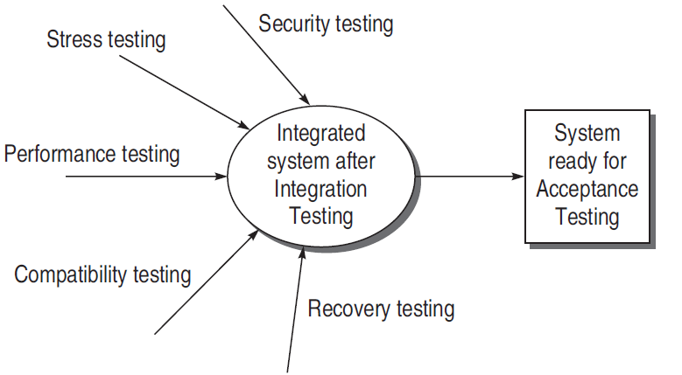
System Testing
System testing includes:
Functional Testing
    Validates functional requirements
Performance Testing
    Validates non-functional requirements
When we are system testing, we are testing all subsystems together

Slide 51
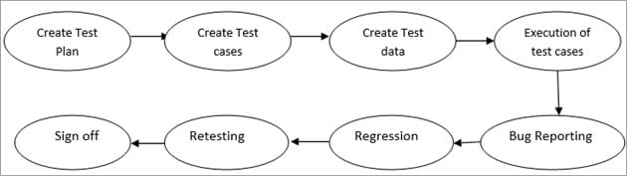
System Testing
Steps in system Testing
The very first step is to create a Test Plan.
Create System Test Cases and test scripts.
Prepare the test data required for this testing.
Execute the system test cases and script.
Report the bugs. Re-testing the bugs once fixed.
Regression testing to verify the impact of the change in the code.
Repetition of the testing cycle until the system is ready to be deployed.
Sign off from the testing team.

Slide 52

System Testing
Procedure To Write System Test Cases
System test cases cover all the scenarios & use cases
it covers functional, non- functional, user interface, security-related test cases.
System test cases commonly include the below fields:

Slide 53
ACCEPTANCE TESTING

Slide 54

User Acceptance Testing(UAT)
Testing is performed by the Client of the application to determine whether the application is developed as per the requirements specified by him/her.
Acceptance testing is the formal testing conducted to determine whether a software system satisfies its acceptance criteria and to enable clients to determine whether to accept the system or not.

Slide 55
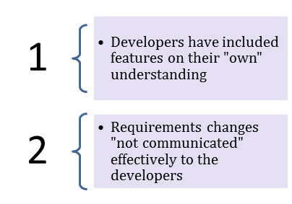
User Acceptance Testing(UAT)
Need of UAT:
Developers code software based on requirements document which is their "own" understanding of the requirements and may not actually be what the client needs from the software.
Requirements changes during the course of the project may not be communicated effectively to the developers.
Running acceptance tests ensures that no requirement change has happened in the meantime and that everything is as it should be to satisfy the customer.

Slide 56
User Acceptance Testing (UAT)
Entry Criteria
System testing is complete and defects identified are either fixed or documented.
Acceptance plan is prepared and resources have been identified.
Test environment for the acceptance testing is available.
Exit Criteria
Acceptance decision is made for the software.
In case of any warning, the development team is notified.

Slide 57
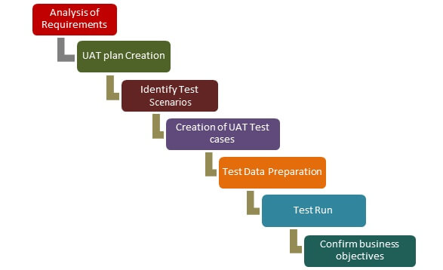
User Acceptance Testing (UAT)
UAT Process:
Once Entry criteria for UAT are satisfied, following are the tasks need to be performed by the testers:
  Analysis of Business Requirements
  Creation of UAT test plan
  Identify Test Scenarios
  Create UAT Test Cases
  Preparation of Test Data(Production like Data)
  Run the Test cases
  Record the Results
  Confirm business objectives

Slide 58
User Acceptance Testing (UAT)
Types of Acceptance Testing
Acceptance testing is classified into the following two categories:
Alpha Testing Tests are conducted at the development site by the end users. The test environment can be controlled a little in this case.
Beta Testing Tests are conducted at the customer site and the development team does not have any control over the test environment.

Slide 59
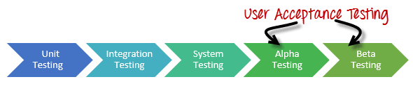
Alpha Testing
Alpha testing is one of the most common software testing strategy used in software development. Its specially used by product development organizations.
  This test takes place at the developer’s site. Developers observe the users and note problems.
  Alpha testing is testing of an application when development is about to complete.
  Minor design changes can still be made as a result of alpha testing.
  Alpha testing is typically performed by a group that is independent of the design team, but still within the company, e.g. in-house software test engineers, or software QA engineers.

Slide 60
Alpha Testing
Entry Criteria to Alpha
  All features are complete/testable (no urgent bugs).
  High bugs on primary platforms are fixed/verified.
  50% of medium bugs on primary platforms are fixed/verified.
  All features have been tested on primary platforms.
  Performance has been measured/compared with previous releases (user functions).
  Usability testing and feedback (ongoing).
  Alpha sites are ready for installation.
Exit Criteria from Alpha
  Get responses/feedbacks from customers.
  Prepare a report of any serious bugs being noticed.
  Notify bug-fixing issues to developers.
  Make sure that no more additional features can be included
  Sign off on Alpha testing

Slide 61
Alpha Testing
Advantages of Alpha Testing:
  Provides better view about the reliability of the software at an early stage
  Helps simulate real time user behavior and environment.
  Detect many showstopper or serious errors
Disadvantages of Alpha Testing:
  In depth functionality of the software cannot be tested as it is still under development stage.

Slide 62

Beta Testing
Beta Testing, also known as “field testing”.
Takes place in the customer’s environment and involves some extensive testing by a group of customers who use the system in their environment.
Beta Testing is performed by "real users" of the software application in a "real environment" and can be considered as a form of external User Acceptance Testing.
Beta version of the software is released to a limited number of end users of the product to obtain feedback on the product quality.
Beta testing reduces product failure risks and provides increased quality of the product through customer validation.
Beta Test provides a complete overview of the true experience gained by the end users while experiencing the product

Slide 63
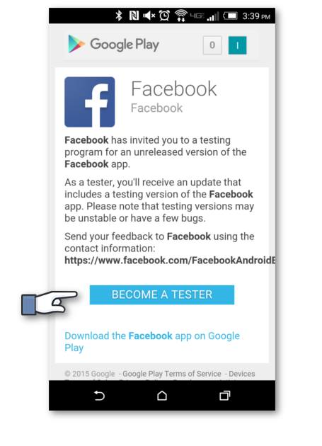
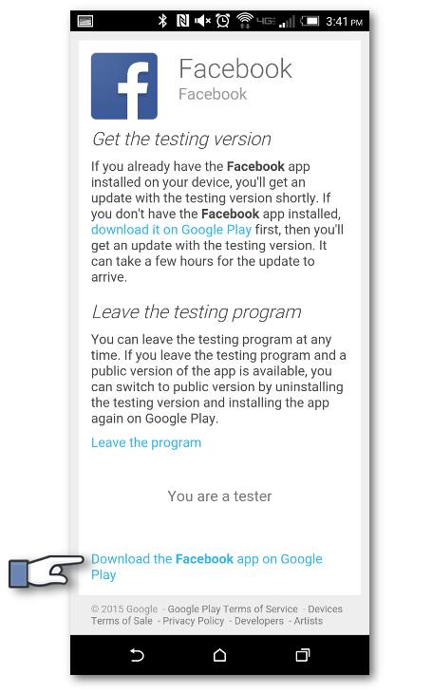
Real People, Real Environment, Real Product are the three R’s of Beta Testing and the question that arises here in Beta Testing is “Do Customers like the Product?”.

Slide 64
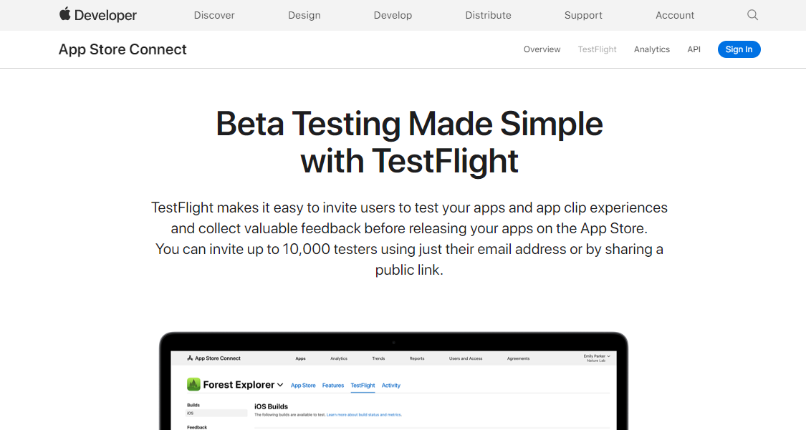

Slide 65
Beta Testing
Entrance criteria for Beta Testing:
  Positive responses from alpha sites.
  Customer bugs in alpha testing have been addressed.
  There are no fatal errors which can affect the functionality of the software.
  Regression testing corresponding to bug fixes has been done.
  Beta sites are ready for installation.
Exit Criteria for Beta Testing:
  Get responses/feedbacks from the beta testers.
  Prepare a report of all serious bugs.
  Notify bug-fixing issues to developers.

Slide 66
Beta Testing
Guidelines for Beta Testing:
  Don’t expect to release new builds to beta testers more than once every two weeks.
  Don’t plan a beta with fewer than four releases.
  If you add a feature, even a small one, during the beta process, the clock goes back to the beginning of eight weeks and you need another 3–4 releases..

Slide 67
Beta Testing
Advantages of Beta Testing:
  Reduces product failure risk via customer validation.
  Beta Testing allows a company to test post-launch infrastructure.
  Improves product quality via customer feedback
  Cost effective compared to similar data gathering methods
Disadvantages of Beta Testing:
  Doesn’t allow any control over the testing as it is carried out in real environment and not under the lab environment.
  Finding the right beta users and maintaining their participation could be a challenge

Slide 68
Alpha Testing Vs Beta testing:
Alpha Testing | Beta Testing
performed by Testers who are usually internal employees of the organization | performed by Clients or End Users who are not employees of the organization
performed at developer's site | performed at client location or end user of the product
Reliability and Security Testing are not performed in-depth Alpha Testing | Reliability, Security, Robustness are checked during Beta Testing
Long execution cycle may be required for Alpha testing | Only few weeks of execution are required for Beta testing

Slide 69
Smoke Testing

Slide 70
Smoke Testing
Assume you order an item from Daraz.
What will you do after getting the parcel form the Daraz delivery man?
check that the parcel is addressed to you
and then make sure parcel is intact and not torn.
Next, you open the parcel and see the item is what you ordered and also make sure it is new, not old.
Well, you just completed your smoke testing on the parcel.
In case of SW testing, Smoke testing is performed on the ‘new’ build given by developers to QA team to verify if the basic functionalities are working or not.
It is the first test to be done on any new build.

Slide 71
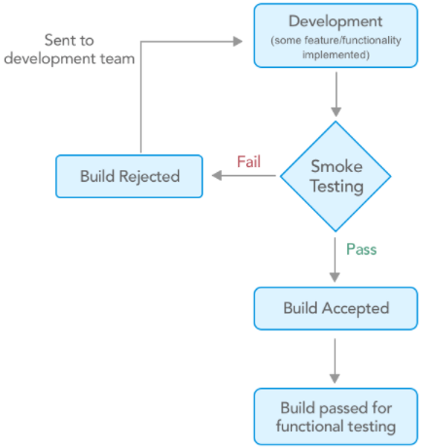
Smoke Testing
In smoke testing, the test cases chosen cover the most important functionality or component of the system.
The objective is not to perform exhaustive testing, but to verify that the critical functionality of the system is working fine.

Slide 72
Smoke Testing
Why do we need Smoke Testing
Just imagine a situation where you have a testing team consisting of 10 members.
all the 10 testers start to test the application and raise the defects for failures they find.
Now, at the end of the day, the development team may come back say, sorry this is not the right build or the QA team may stop the testing saying there are too many issues.
But again 10 people have already wasted their 8 hours for this which means 80 hours of productivity is lost.
This is the reason why we need to have a smoke test done, before jumping into a full-fledged testing cycle.

Slide 73
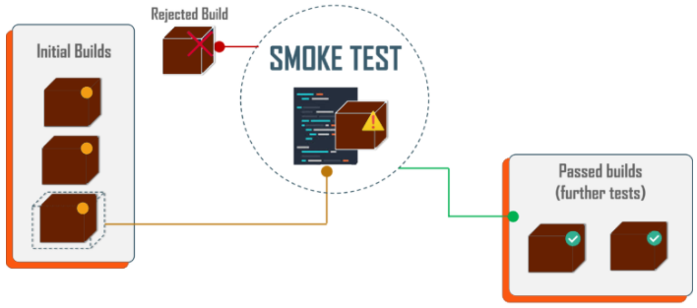
Smoke Testing
When and How Often do We Need Smoke Testing?
Smoke Testing normally takes a maximum of 60 minutes and should be done for every new build.
Once the product is stable, you can even think about automating the smoke tests.
a smoke test is very critical, because it will prevent an unstable or broken build from being pushed into production.

Slide 74
Smoke Testing
Advantages:
It helps to find faults earlier in the product lifecycle.
It saves the testers time by avoiding testing an unstable or wrong build
It provides confidence to the tester to proceed with testing
It helps to find integration issues faster
Major severity defects can be found out
Detection and rectification will be an easy process
Since execution happens quickly, there will be a faster feedback

Slide 75
Sanity Testing

Slide 76
Sanity Testing
When a new build is received with minor modifications, instead of running a thorough regression test suite we perform a sanity test.
It determines that the modifications have actually fixed the issues and no further issues have been introduced by the fixes.
Sanity testing is generally a subset of regression testing and a group of test cases executed that are related to the changes made to the product.
Many testers get confused between sanity testing and smoke testing

Slide 77
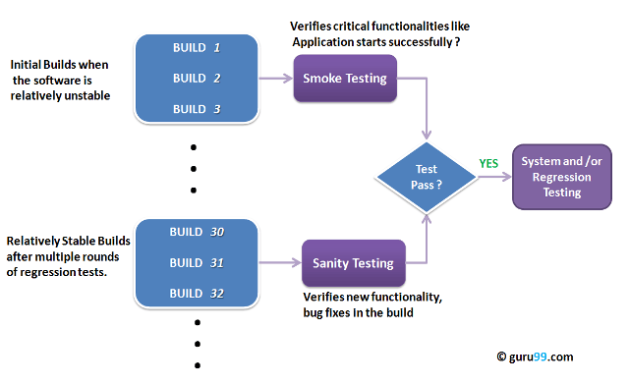

Slide 78
Regression Testing

Slide 79
Regression Testing
Is a type of software testing to confirm that a recent program or code change has not adversely affected existing features.
Is nothing but a full or partial selection of already executed test cases which are re-executed to ensure existing functionalities work fine.
Regression test cases - carefully selected to cover as much of the system as possible that can in any way have been affected by a maintenance change or any kind of change.

Slide 80
Regression Testing
Regression testing is crucial during maintenance.
It is a good idea to automate regression testing so that all test cases are run after each modification to the software
When you find a bug in your program you should write a test case that exhibits the bug.
Then using regression testing you can make sure that the old bugs do not reappear

Slide 81
Regression Testing
When and How Often do We Need Regression Testing?
We typically think of regression testing as a software maintenance activity
Few cases when we need to perform regression test:
  Addition of new functionalities
  Change requirements
  After bug fix
  Performance issue
  Environment change
Challenges:
Time Consuming
Expensive
Complex

Slide 82
Non Functional Testing

Slide 83
Non-Functional Testing
The Major Non-Functional Testing techniques include:
  Performance testing
  Load testing
  Stress testing
  Scalability testing
  Stability testing
  Compatibility testing
  Compliance testing
  Recovery testing
  Security testing
  Usability testing

Slide 84
Performance Testing

Slide 85
Performance Testing
is a type of software testing that ensures that the software applications will perform well under their expected workload.
The goal of performance testing is not to find bugs but to eliminate performance bottlenecks.
Performance testing measures the quality attributes of the system, such as scalability, reliability and resource usage.

Slide 86
Performance testing
Some of the factors that governs Performance testing:
  Throughput
  Response Time
  Tuning
  Benchmarking

Slide 87
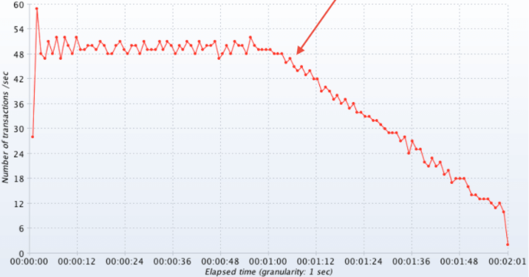
Performance testing
Throughput:
Capability of a product to handle multiple transactions in a give period.
Throughput represents the number of requests/business transactions processed by the product in a specified time duration [typically measured as total no. of transaction or requests in a given time or TPS (transaction per second].
It is one of the significant indicator that helps in evaluating the performance of application.

Slide 88
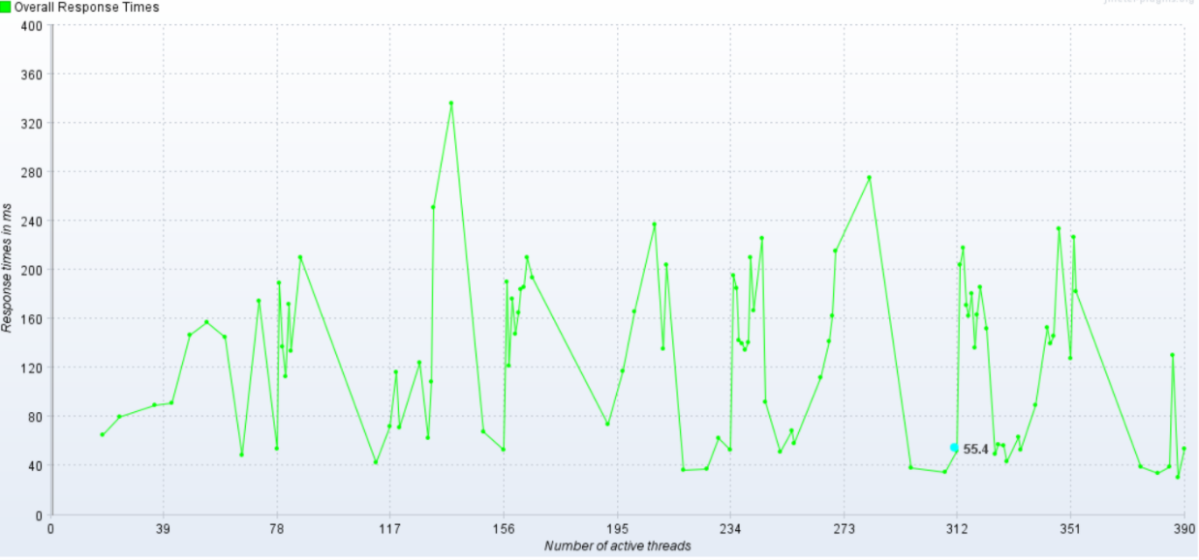
Performance testing
Response Time:
It is equally important to find out how much time each of the transactions took to complete.
Response time is defined as the delay between the point of request and the first response from the product.
The response time increases proportionally to the user load.

Slide 89
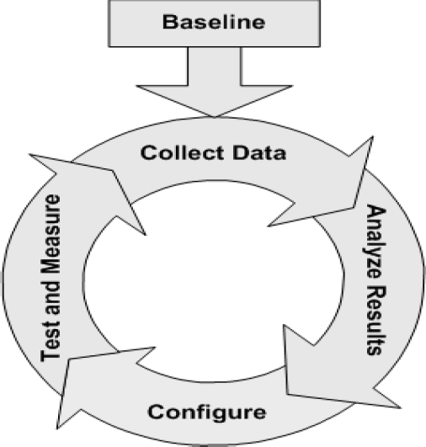
Performance testing
Tuning:
Tuning is the procedure by which product performance is enhanced by setting different values to the parameters of the product, operating system and other components.
Tuning improves the product performance without having to touch the source code of the product.

Slide 90
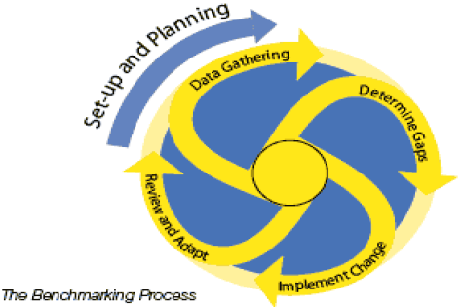

Performance testing
Benchmarking:
A very well-improved performance of a product makes no business sense if that performance does not match up to the competitive products.
A careful analysis is needed to chalk out the list of transactions to be compared across products so that an apple-apple comparison becomes possible.

Slide 91
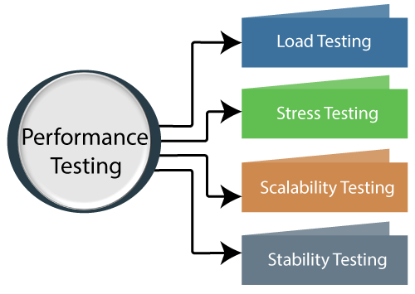
Performance testing
Types of Performance Testing:

Slide 92

Performance testing
Load Testing
Load testing is performance testing technique using which the response of the system is measured under various load conditions.
The load testing is performed for normal and peak load conditions.
is used to check the performance of an application by applying some load which is either less than or equal to the desired load.

Slide 93
Performance testing
Stress Testing:
Stress testing a Non-Functional testing technique that is performed as part of performance testing.
During stress testing, the system is monitored after subjecting the system to overload to ensure that the system can sustain the stress.
That is with stress testing we check the behavior of an application by applying load greater than the desired load.
The recovery of the system from such phase (after stress) is very critical as it is highly likely to happen in production environment.

Slide 94
Performance testing
Reasons for conducting Stress Testing:
It allows the test team to monitor system performance during failures/heavy load.
To verify if the system has saved the data before crashing or NOT.
To verify if the system prints meaning error messages while crashing or did it print some random exceptions.
To verify if unexpected failures do not cause security issues.

Slide 95
Performance testing
Scalability Testing:
Checking the performance of an application by increasing or decreasing the load in particular scales (no of a user) is known as scalability testing.
Scalability testing is divided into two parts which are as follows:
  Upward scalability testing: It is testing where we increase the number of users on a particular scale until we get a crash point. We will use upward scalability testing to find the maximum capacity of an application.
  Downward scalability testing: The downward scalability testing is used when the load testing is not passed, then start decreasing the no. of users in a particular interval until the goal is achieved. So that it is easy to identify the bottleneck (bug).

Slide 96
Performance testing
Stability Testing:
Checking the performance of an application by applying the load for a particular duration of time is known as Stability Testing.

Slide 97
Recovery testing
Recovery testing is a type of non-functional testing technique performed in order to determine how quickly the system can recover after it has gone through system crash or hardware failure.
Recovery testing is the forced failure of the software to verify if the recovery is successful.

Slide 98
Security testing
Security testing is a testing technique to determine if an information system protects data and maintains functionality as intended.
Process intended to reveal ﬂaws in the security mechanisms of an information system
Finding out the potential loopholes & weakness of the system
To check whether there is an information leakage

Slide 99
Security Testing
Aims to verify 6 basic principles as listed below:
  Confidentiality – Is my secret safe…
  Integrity – Is my data tampered..
  Authentication – Who am I? Something you know!! Something you have!
  Authorization – What can I do..
  Availability –Do the information ready for use when expected..
  Non-repudiation - prevent the later denial that an action happened, or a communication that took place

